Slide 1
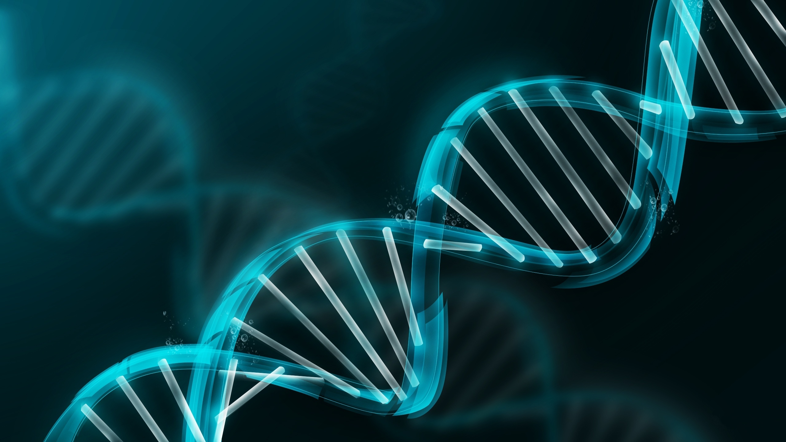

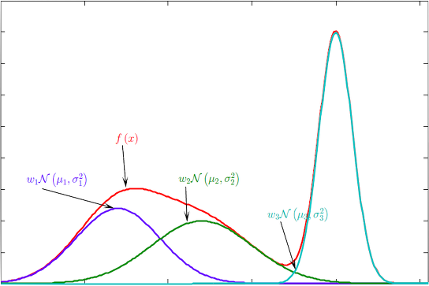
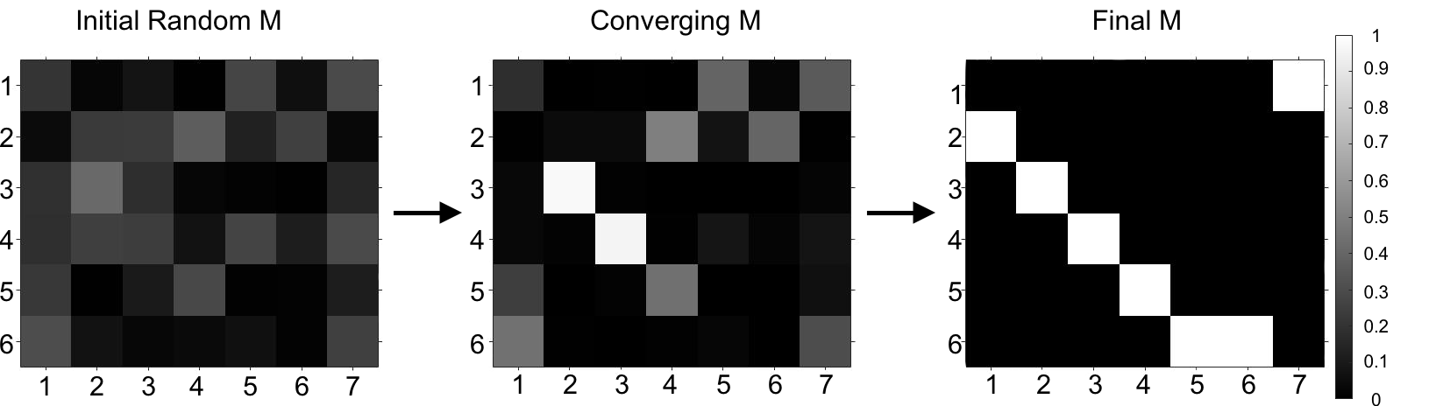
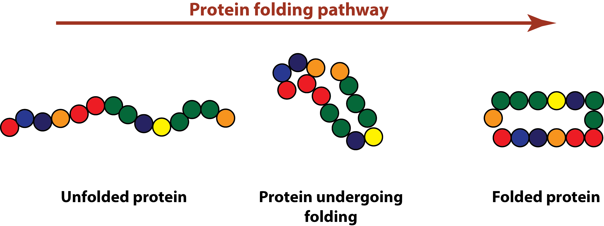
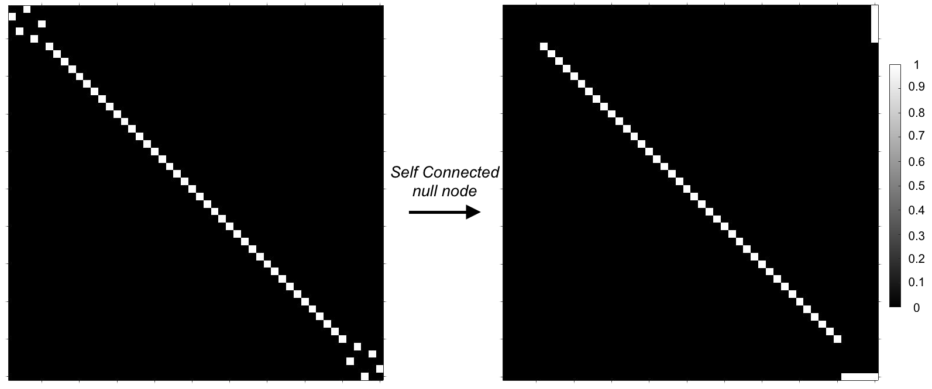
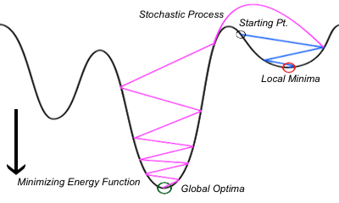
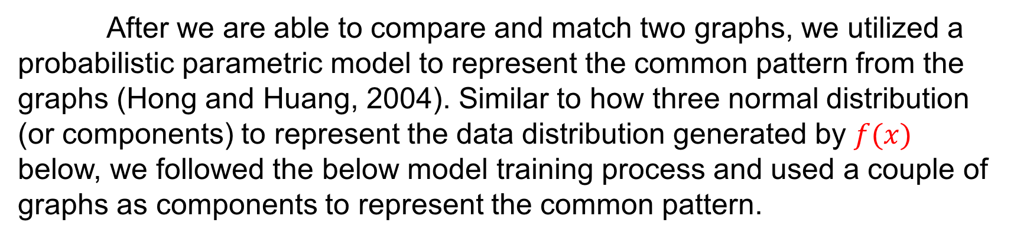
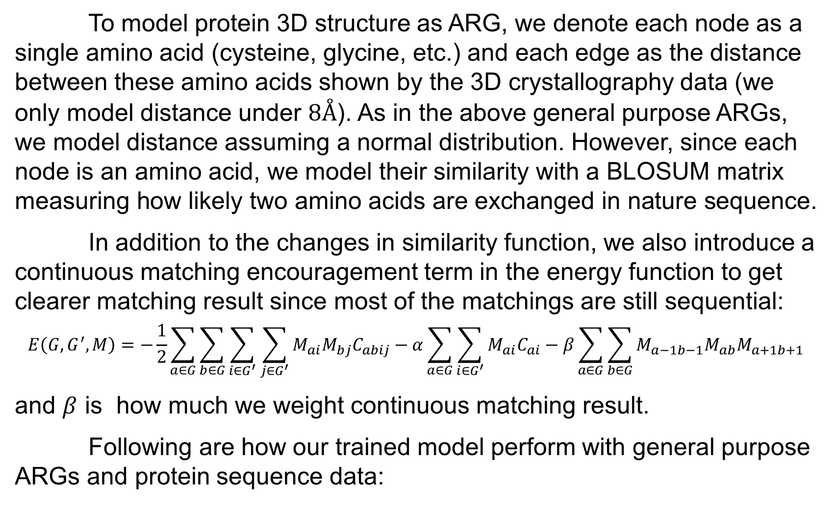
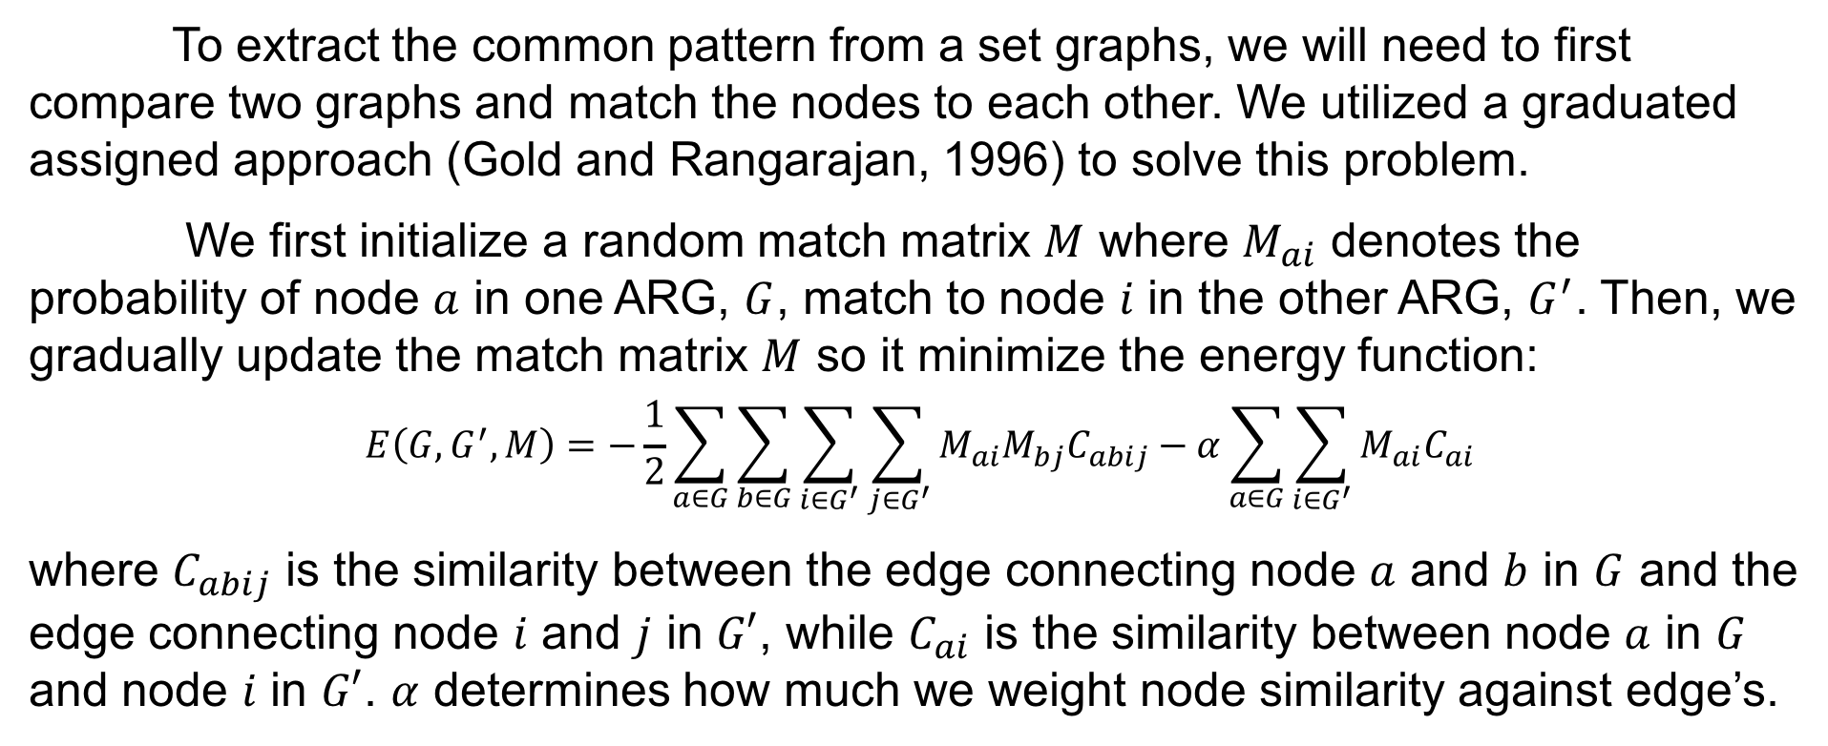
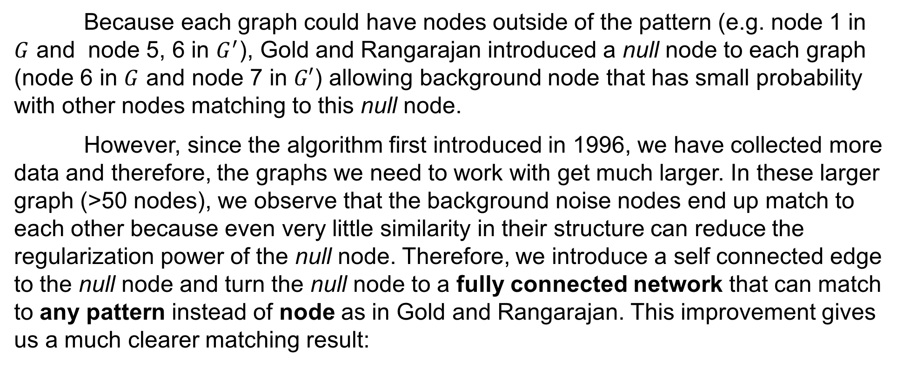
Graph Matching, Pattern Learning, and Protein Modeling
Wesley W. Qian, Pengyu Hong | Computer Science Department, Brandeis University, Waltham, MA, USA
I. Introduction
II. Graph Matching
III. Pattern Learning
One of the most amazing capabilities of human beings is to extract common spatial patterns from observations and use these patterns to make inference. For example, even if you do not know Woody and I tell you that below are two pictures of him, you will most likely be able to recognize him since he is the only person (i.e. the spatial pattern in our case) showing up in both pictures:
To extract the common pattern from a set graphs, we will need to first compare two graphs and match the nodes to each other. We utilized a graduated assigned approach (Gold and Rangarajan, 1996) to solve this problem.
We first initialize a random match matrix $M$ where $M_{ai}$ denotes the probability of node $a$ in one ARG, $G$, match to node $i$ in the other ARG, $G^{′}$. Then, we gradually update the match matrix $M$ so it minimize the energy function:
$$E\left(G,G^{′},M\right)=−\frac{1}{2}\sum_{a∈G}{\sum_{b∈G}{\sum_{i∈G^{′}}{\sum_{j∈G^{′}}{M_{ai}M_{bj}C_{abij}}}}}−α\sum_{a∈G}{\sum_{i∈G^{′}}{M_{ai}C_{ai}}}$$
where $C_{abij}$ is the similarity between the edge connecting node $a$ and $b$ in $G$ and the edge connecting node $i$ and $j$ in $G′$, while $C_{ai}$ is the similarity between node $a$ in $G$ and node $i$ in $G′$. $α$ determines how much we weight node similarity against edge’s.
After we are able to compare and match two graphs, we utilized a probabilistic parametric model to represent the common pattern from the graphs (Hong and Huang, 2004). Similar to how three normal distribution (or components) to represent the data distribution generated by $f(x)$ below, we followed the below model training process and used a couple of graphs as components to represent the common pattern.
Model Training Process
1st Randomly pick $n$ graphs as components
2nd Perform graph matching between components and sample graphs
EM Iterations
3rd Update nodes and edges of the components based on the graph matching result
To represent these spatial patterns, we utilized a graph representation in computer science called ARGs (attributed relational graphs) consisting of labelled nodes connected by labelled edges:
G
G’
4th Output the components once the update is small
2
1
1
2
5
Once we trained such model, we can determine whether a new sample graph contains the common pattern by comparing it with the components in the model via graph matching as shown below.
3
3
4
6
4
6
5
7
IV. Protein Modeling
Because each graph could have nodes outside of the pattern (e.g. node 1 in $G$ and node 5, 6 in $G^{′}$), Gold and Rangarajan introduced a null node to each graph (node 6 in $G$ and node 7 in $G′$) allowing background node that has small probability with other nodes matching to this null node.
However, since the algorithm first introduced in 1996, we have collected more data and therefore, the graphs we need to work with get much larger. In these larger graph (>50 nodes), we observe that the background noise nodes end up match to each other because even very little similarity in their structure can reduce the regularization power of the null node. Therefore, we introduce a self connected edge to the null node and turn the null node to a fully connected network that can match to any pattern instead of node as in Gold and Rangarajan. This improvement gives us a much clearer matching result:
To model protein 3D structure as ARG, we denote each node as a single amino acid (cysteine, glycine, etc.) and each edge as the distance between these amino acids shown by the 3D crystallography data (we only model distance under $8Å$). As in the above general purpose ARGs, we model distance assuming a normal distribution. However, since each node is an amino acid, we model their similarity with a BLOSUM matrix measuring how likely two amino acids are exchanged in nature sequence.
In addition to the changes in similarity function, we also introduce a continuous matching encouragement term in the energy function to get clearer matching result since most of the matchings are still sequential:
$$E\left(G,G^{′},M\right)=−\frac{1}{2}\sum_{a∈G}{\sum_{b∈G}{\sum_{i∈G^{′}}{\sum_{j∈G^{′}}{M_{ai}M_{bj}C_{abij}}}}}−α\sum_{a∈G}{\sum_{i∈G^{′}}{M_{ai}C_{ai}}−β\sum_{a∈G}{\sum_{b∈G}{M_{a−1b−1}M_{ab}M_{a+1b+1}}}}$$
and $β$ is how much we weight continuous matching result.
Following are how our trained model perform with general purpose ARGs and protein sequence data:
and we build algorithms to compare different ARGs (this is called graph matching/graph alignment) and extract the common pattern (the orange part) while ignore the background noise (the purple, black, and blue part) from the ARGs (this is called pattern learning).
One important application of such algorithms would be modeling proteins in their 3D structures. Proteins are macromolecules responsible for nearly every task of cellular life. They are first generated by DNA (the poster background!) as a linear sequence of amino acids and then folded as a 3D structure in order to function:
……
…
Self connected null node
……
…
Another issue we encountered while working with these larger graphs are local minima. Because larger graphs can have multiple similar structures itself, the algorithm can get confused and return a suboptimal matching result instead of a global optimal result. To solve this problem, we introduce a stochastic/random process in the algorithm and allow us to explore different matching result instead of stuck in an converging path to suboptimal solution. The improvement is significant:
Conventional computational methods model proteins in their unfolded sequence form, and ignore the 3D nature of proteins. By modeling protein in their 3D structure and taking advantage of the available 3D structure data, our algorithms have the potential to discover new structure patterns in proteins that are impossible to discover in their linear structure.
V. Future Direction
In the following sections, we will introduce the methods we used and improvements we made to perform 1) graph matching, 2) pattern learning and 3) protein modeling, and discuss 4) the future directions of the project.
The next step of the project, which I am still working on now, would be modeling the amino acid node with a continuous representation since such representation is more dense and its variance is also of interest for biologist. In addition, we also want to apply the algorithm to a larger and more diverse dataset to discover novel smaller structure in protein.
Acknowledgement
I thank Prof. Penyu Hong for his continuous support, inspiration and guidance. This work is supported by the Jerome A. Schiff Fellowship.

